Slide 1
Dynamic Difficulty Adjustment with Reinforcement Learning in Educational Video Game
Supervisors: John Woodward & Atm Alam
Independent Assessor: Paulo Rauber
Name: Jianshu Qiao
Date: 15.Feb 2023

Slide 2
Overview
1
2
3
Word Maker
Two Problems
My solution

Slide 3
Part One
Word Maker

Slide 4
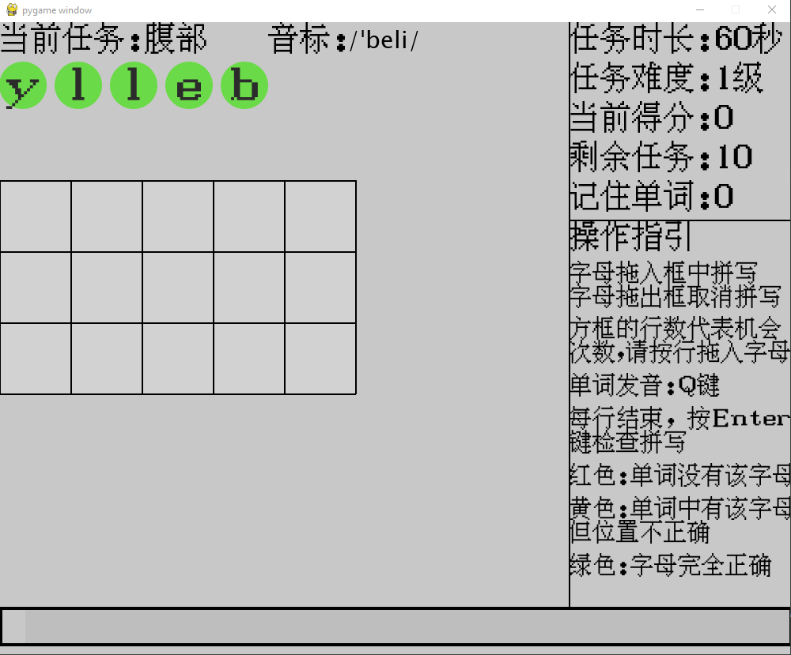
Word Maker
1: Current Task
2: Phonetic
3: Letters
4: Chances
5: Time Limitation
6: Difficulty Level
7: Score
8: Remaining Tasks
9: Learned Words
10 Operating Instructions
11: Time Progress Bar
Game Characteristics
Rewards
Goals
Rules
Control
Sensory
Stimuli
Feedback
Learning Theories
Intentional
learning
Trial and Error
Spaced
Repetition
Test
Effects
Classroom
Implementation
Syllabus
Time
Hardware
Words serve syllabus
20 words in 40 minutes
Any Computers
Easy of Use
Effortless

Slide 5
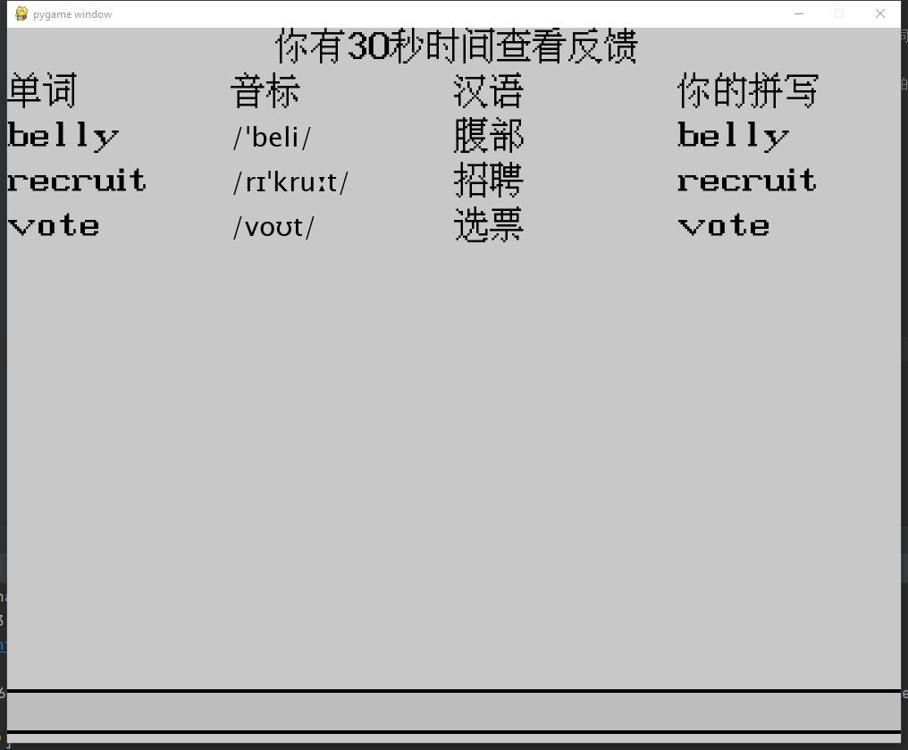
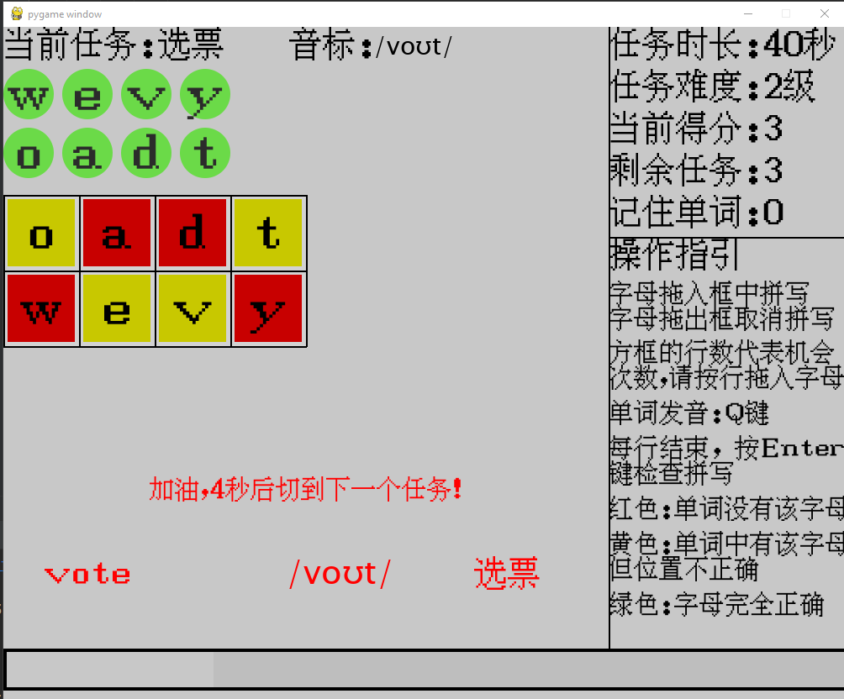
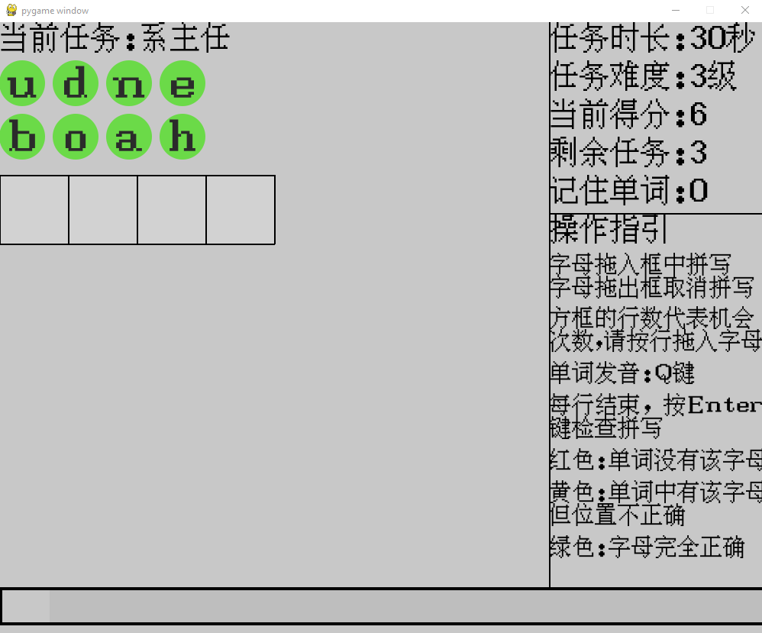
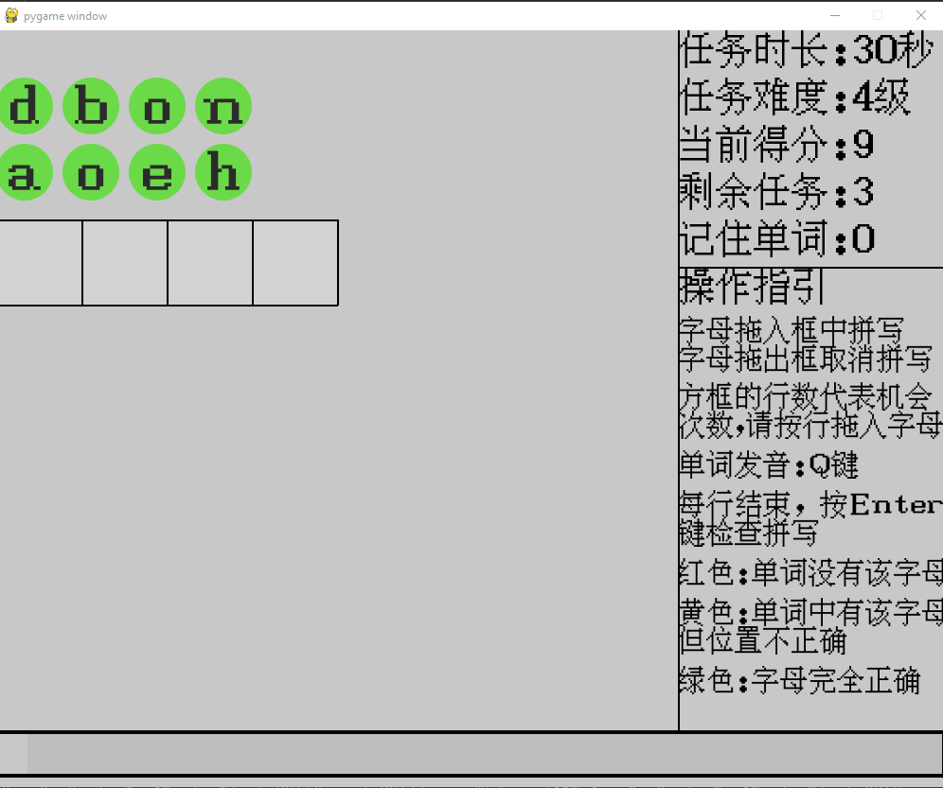
Test Effects
Test Effects
Performance
Side Effects
Feedback
Support Cue
The combination of test-study model is more effective than repeated study
Weak Support Cue is good for long-term retention, and Strong Support Cue is good for short-term learning
Test effects also enhance the false memory
Feedback not only can mitigate the side effects, but also can enhance the memory
One Session
Loop 1
Test_1 | Study_1
Loop 2
Test_2 | Study_2
Loop 3
Test_3 | Study_3
Loop 4
Test_4 | Study_4

Slide 6
Part Two
Two Problems

Slide 7
Current Problems
Problems One: Enjoyment: Enjoyment is important to (1) keep lasting motivation and concentration, e.g., 30 minutes; (2) autonomous learning, e.g., 30 minutes a day, three times a week
My problems: How to achieve the two objectives? (badge, score?)
Problems Two: Dynamic Difficulty Adjustment
Student_1: Cat, Big, Horse, Elephant. The learning speed of each word is different.
 | Loop_1 | Loop_2 | Loop_3 | Loop_4
Cat | d₁ | d₄
Elephant | d₁ | d₂ | d₃ | d₄
Student_1 and Student_2 : Cat, Big, Horse, Elephant. The difficulty of same word is different for each student.
 | Loop_1 | Loop_2 | Loop_3 | Loop_4
Elephant | d₁ | d₂ | d₃ | d₄
Elephant | d₁ | d₂ | d₄

Slide 8
Expected Learning Process
Task Pool
Cat: current deck
Dog: current deck
Fish: 0-2-5-9 file
Bee: 1-3-6-0 file
Crab: 5-7-0-4 file
Cut: 8-0-3-7 file
Present Tasks
Cat
Dog
Fish
Bee
Crab
Cut
Test_1
Cat: d_1
Dog: d_1
Fish: d_1
Bee: d_1
Crab: d_1
Cut: d_1
Study_1
Cat: cgt
Dog: dog
Fish: fesh
Bee: bee
Crab: creb
Cut: cvt
Test_2
Cat: d_2
Dog: d_3
Fish: d_4
Bee: d_4
Crab: d_1
Cut: d_2
Study_2
Cat: cet
Dog: dog
Fish: Fish
Bee: Bee
Crab: creb
Cut: cit
Advantages:
(1): save time
(2): balance students’ English proficiency and learning speed
(3) Feel boring or frustrated
(4) Keep Effectiveness
Study_4
Cat: cgt
Dog: dog
Fish: Fish
Bee: Bee
Crab: creb
Cut: cvt
Test_4
Cat: d_4
Dog: d_4
Crab: d_4
Cut: d_4
Study_3
Cat: cgt
Dog: dog
Fish: Fish
Bee: Bee
Crab: creb
Cut: cvt
Test_3
Cat: d_2
Dog: d_3
Crab: d_3
Cut: d_4

Slide 9
Part Three
My solution

Slide 10
Player Features
All Player Features
Word | Word Length | Attempts | Time consumed | Difficulty level | The number of yellow | The number of red | The number of green
Selected Player Features
Attempts | Time consumed | Difficulty level
 | D_1 | D_2 | D_3 | D_4
Attempts | 0-3 | 0-2 | 0 and 1 | 0 and 1
Time consumed (Seconds) | 0-60 | 0-40 | 0-30 | 0-30
Difficulty level | 1 | 2 | 3 | 4
Possibilities (State Space) | 182 | 81 | 31 | 31

Slide 11
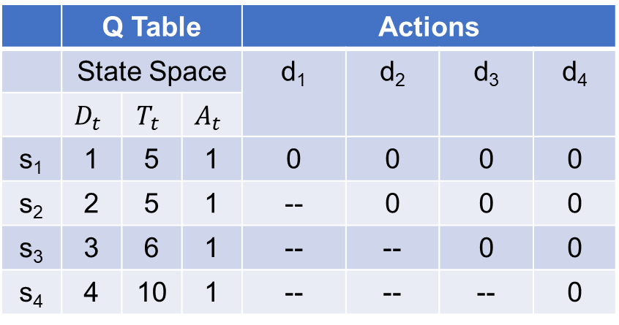
Reinforcement Learning
 | Q Table |  |  | Actions
 | State Space |  |  | d₁ | d₂ | d₃ | d₄
 | $$D_{t}$$ | $$T_{t}$$ | $$A_{t}$$
s₁ | 1 | 5 | 1 | 0 | 0 | 0 | 0
s₂ | 2 | 5 | 1 | -- | 0 | 0 | 0
s₃ | 3 | 6 | 1 | -- | -- | 0 | 0
s₄ | 4 | 10 | 1 | -- | -- | -- | 0
State
(1, 5, 1)
Action
D₂
D₁ (Environment)
Cat
Agent
D₂ (Environment)
Cat
Result
Correct
States
(2, 5, 1)
Result
Correct
State
(4, 10, 1)
Action
D₄
Agent
(Q table)
D₄ (Environment)
Cat
Agent
(Q table)
Result
Correct
Objectives: (1) make sure the accuracy of each step. (5) difficulty does not decrease. Either (2) reach the d₄ as soon as possible (find the shortest episode). Keep or upgrade
(3) the maximum number of step is 4.
(4) the difficulty of level at step₁ is always D₁, and the step₄ is d₄.
Rewards : cat: d₁ (correct), d₂ (correct), d4 (correct) , increase Q (s₁,d₂) ,Q (s₂,d₄), Q (s₁,d₄);
cat: d₁ (correct), d₂ (correct), d4 (wrong) , increase Q (s₁,d₂) , decrease Q (s₂,d₄), Q (s₁,d₄);
Problem: The frequency of each state differ. Therefore, I plan to collect data from players for training the model.
Questions: Can we create a virtual player to simulate students’ learning process?

Slide 12
Further Question
181 _{d1} | Attempt | Time consumed (Seconds) | Difficulty level
 | 1 | 1 | 1
 | 1 | 13 | 1
 | 2 | 10 | 1
 | 3 | 28 | 1
 | 3 | 29 | 1
 | …… | …… | ……
81 _{d2} | Attempt | Time consumed (Seconds) | Difficulty level
 | 1 | 6 | 2
 | 1 | 7 | 2
 | 1 | 8 | 2
 | 2 | 15 | 2
 | 2 | 16 | 2
 | …… | …… | ……
Can we create a virtual player to simulate students’ learning process?
The combination of a State [D_{t}, T_{t}, A_{t}] and Result [right and wrong] can simulate real player.
(1): The frequency of each State differs for students with different English proficiency. How do I define selection policy?
(2): The accuracy of each step should increase because you learned the word in the study part and feedback.
How do I give Result to State of each step?
31 _{d1} | Attempt | Time consumed (Seconds) | Difficulty level
 | 1 | 7 | 3
 | 1 | 8 | 3
 | 1 | 9 | 3
 | 1 | 27 | 3
 | 1 | 28 | 3
 | …… | …… | ……
31 _{d1} | Attempt | Time consumed (Seconds) | Difficulty level
 | 1 | 8 | 4
 | 1 | 9 | 4
 | 1 | 10 | 4
 | 1 | 11 | 4
 | 1 | 12 | 4
 | …… | …… | ……

Slide 13
Thanks for your time

